Slide 1

Deepti Kulkarni
Want to be host?
Read more to find the best price for your property.

Slide 2
Agenda
Purpose of the Data mining project
Data Mining steps walkthrough
Overview of Data collection, preprocessing and dimension reduction.
Master Cluster and Cluster Split
Cluster 1 , 2 and 3
Multiple regression, Regression tree, Neural network
Model comparison and Best model for each cluster
Conclusion
Recommendation

Slide 3
Purpose
Determine the right price for your house on AirBnB.
What predictors contribute the most to determining the price of a house?
How will the stakeholder use the results?
Will the effect be an ongoing procedure?

Slide 4

Data Mining Steps
Data Collection:
This dataset consists of data for different parameters which potentially define the price of a room.
The dataset includes logprice as response variable and 28 predictors.
Dataset contains 74.1k records with 29 unique variables.

Slide 5
Explore, Clean and Preprocess Data
Renaming variables
Defining types of each variable
Handling multi-valued categorical variables
Creating new columns
Handling missing data
Detecting outliers

Slide 6
Handling categorical variables
Nominal categorical variables cannot be used directly, they must be decomposed into binary indicator variables to be used in analysis. There are two different nominal variables in the dataset.
Type 1: Handling string values in the variables.
Type II: Handling multivalued nominal variables.
Variable | One of the Value
Amenities | TV","Cable TV",Internet,"Wireless Internet","Air conditioning",Kitchen,"Buzzer/wireless intercom",Heating
Variable | Possible Values
PropertyType | Apartment House Condominium Loft
Decomposed the string to extract values using excel, and created indicator columns for each of the value
Used JMP Pro “Make Indicator Columns” option in Cols->Utilities to create indicator columns for each possible value of PropertyType.

Slide 7
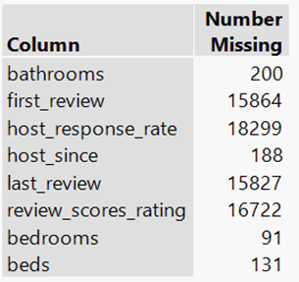
Handling missing values
Used “Explore Missing Values” option to JMP to find the variables with missing values.
Used inbuilt imputation in JMP “Automated Data Imputation” method to fill missing values with reasonable substitutes.

Slide 8
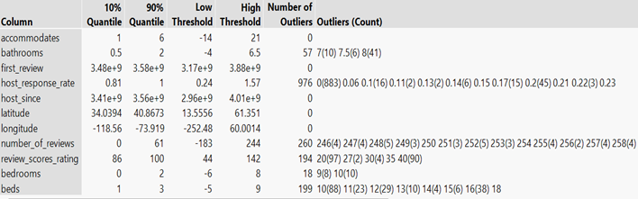
Detecting outliers
Compared the outliers obtained with the actual range of data for each variable.
After further analysis, the outliers obtained are ruled out to be abnormal and the data corresponding to them is used further.

Slide 9
Variables selection & Dimension Reduction
Used multivariate method to analyze the correlation between the response variable and the predictors.
Removed the variables with least correlation between response variable and the predictors and have high correlation between other predictors.
Also removed categorical variables with least significance to the response variable and the business.
Removed redundant variables( same variables with different names).

Slide 10
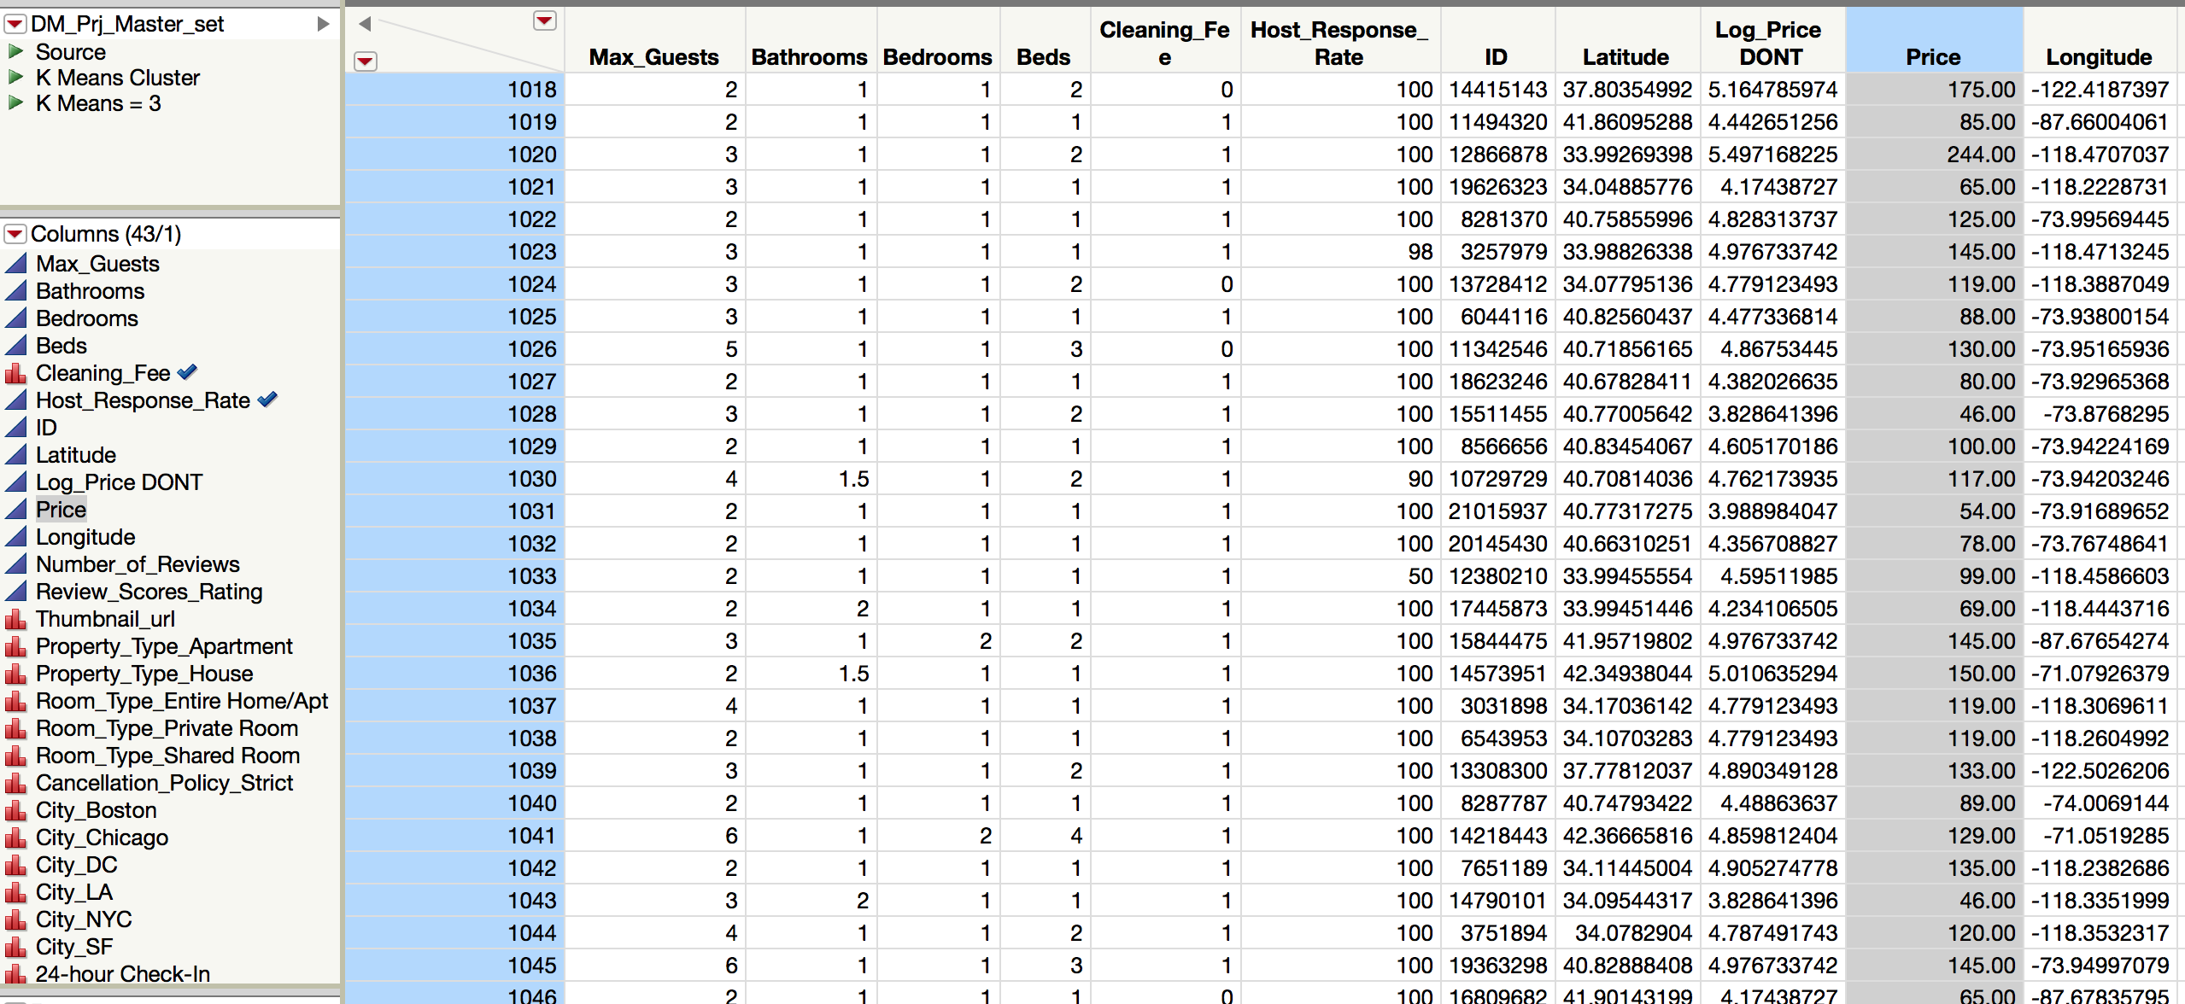

Slide 11
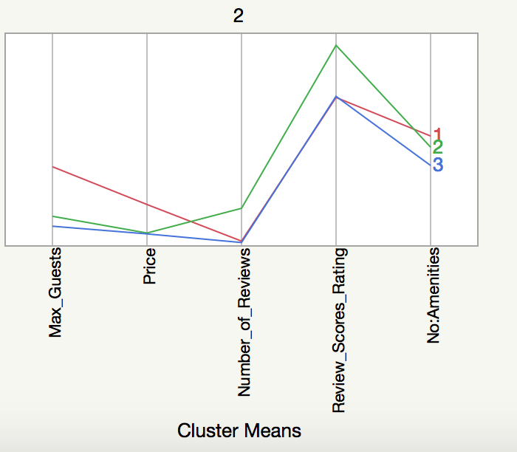
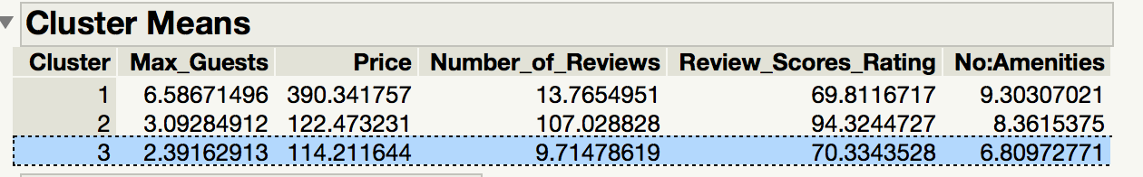
Cluster Analysis
Goal : Separate data into homogenous records to improve supervised learning
Number of cluster - 3
Method - K Means Cluster
With few chosen variables

Slide 12
Cluster Analysis
Recoding the clusters :
Maximum guests
Review Score Rating
Cluster | Max_Guests | Price | Number_of_ Reviews | Review_ Scores_ Rating
1 | small space(<4) | Low price(<350$) | high (>50) | high(>75%)
2 | small space | Low price | low (<25) | low(<50%)
3 | big space (>4) | High price (<350$) | low | low

Slide 13
Cluster Analysis
Cluster | Recode
1 | Small Space & High Rating
2 | Small Space & Low Rating
3 | Big Space & Low Rating

Slide 14
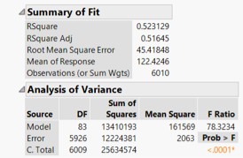
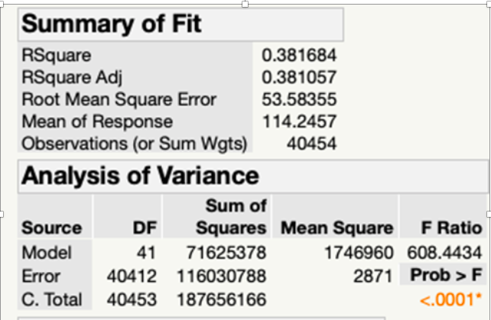
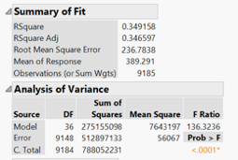
Multiple Regression- Forward Selection
CLUSTER1 CLUSTER 2 CLUSTER 3
Clusters | 1 | 2 | 3
Validation R Square | 0.465 | 0.389 | 0.349
Validation RASE | 47.22 | 52.50 | 246.1

Slide 15
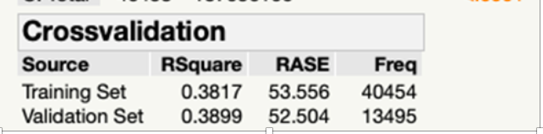
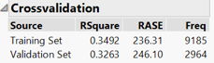
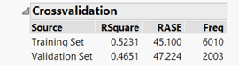
Multiple Regression Cntd
CLUSTER1 CLUSTER 2 CLUSTER 3
Percentage Change in RASE | -4.70% | +1.96% | -4.14%
Percentage change in R Square | -11.08% | +2.14 % | -6.5%
Overfitting | No Overfitting | No Overfitting | No Overfitting
Most Contributing variables | Room type_Entire room/Apt | Bedrooms | Bathrooms

Slide 16
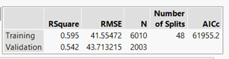
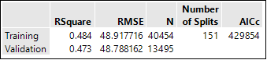
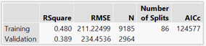
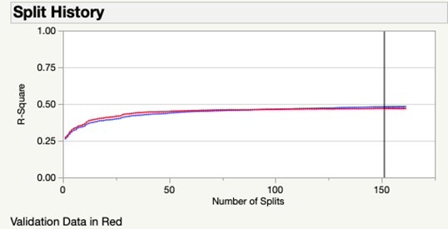
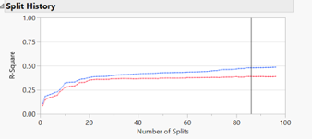
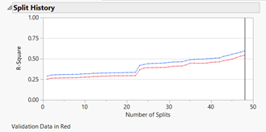
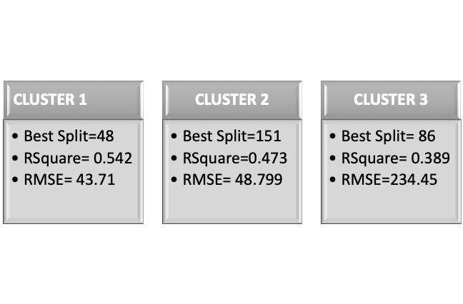
Regression Tree
CLUSTER 1 CLUSTER 2 CLUSTER 3

Slide 17
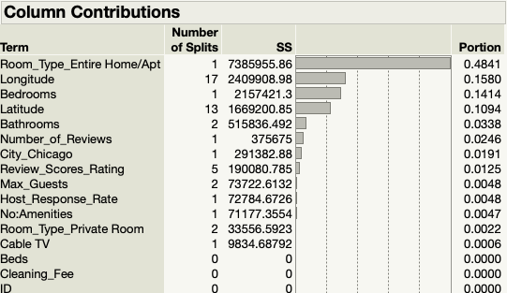
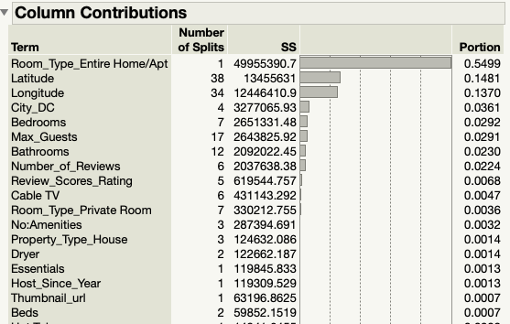
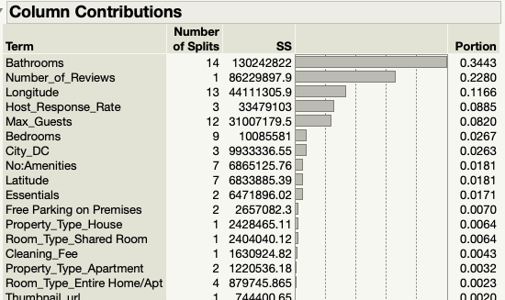
Regression Tree Contd.
CLUSTER1 CLUSTER 2 CLUSTER 3
Change in RMSE | 5.1% | 0.2% | 9.9%
Change In R Square | 8.9% | 2.27% | 18.95%
OverFitting | No | No | No
Most Contributing variable to Response | Room type_Entire room/Apt | Room type_Entire room/Apt | Bathrooms

Slide 18
Regression Tree Contd.
CLUSTER 2: Leaf report Example
When Entire Home/ Apt is rented, with bathrooms >=1.5 , then predicted average price is $230.68
Regression Tree VS Multiple Regression
For all the 3 clusters, the validation RSquare is higher and RMSE is lower in Regression Tree. Thus regression tree is better model for predicting price among all clusters

Slide 19
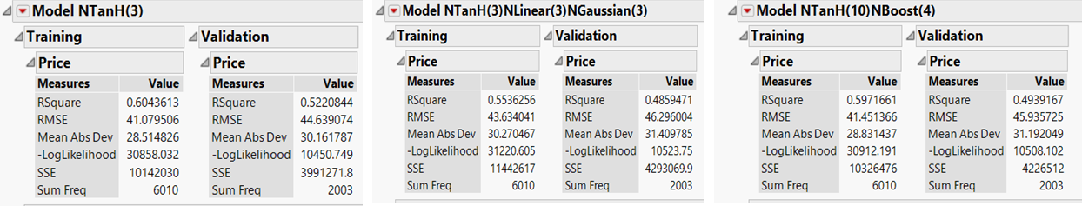
Neural Networks: Cluster 1
 | NTanH(3) | NTanH(3)NLinear(3)NGaussian(3) | NTanH(10)NBoost(4)
Change in RMSE | 8.6% | 6% | 10.8%
change in R Square | 13.5%. | 12.2%. | 17.4%.
Profiler -Most contributing variables with Price | Beds, Review_Scores_Rating | Max_Guests, Bedrooms | Review_Scores_Rating

Slide 20
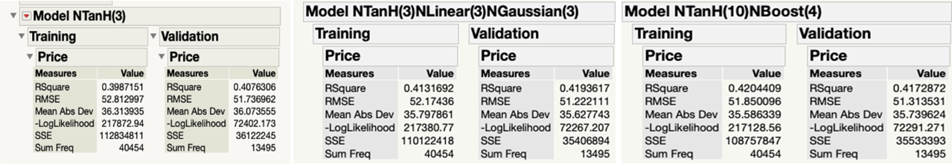
Neural Networks: Cluster 2
 | NTanH(3) | NTanH(3)NLinear(3)NGaussian(3) | NTanH(10)NBoost(4)
Change in RASE | 2% | 1.8% | 1.0%
change in R Square | 2.2% | 1.4% | 0.7%
Profiler - Most contributing variables with Price | Bedrooms, Latitude | Room_Type, Bedrooms | Room_Type

Slide 21
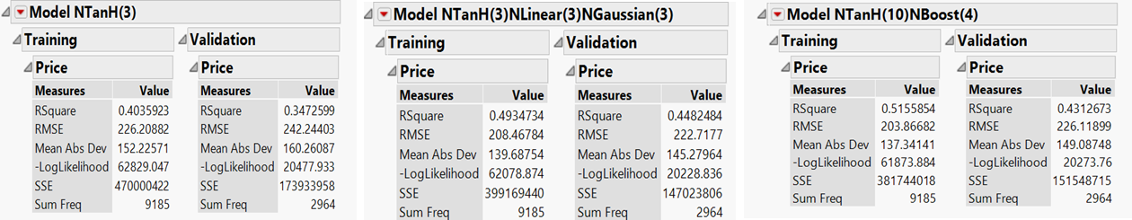
Neural Networks: Cluster 3
 | NTanH(3) | NTanH(3)NLinear(3)NGaussian(3) | NTanH(10)NBoost(4)
Change in RASE | 7.08% | 6.8% | 10.9%
change in R Square | 13.9% | 9.2% | 16.3%.
Profiler - Most contributing variables with Price | Room_Type, Bedrooms | Room_Type,Beds | Review_Score, Beds, Room_Type

Slide 22
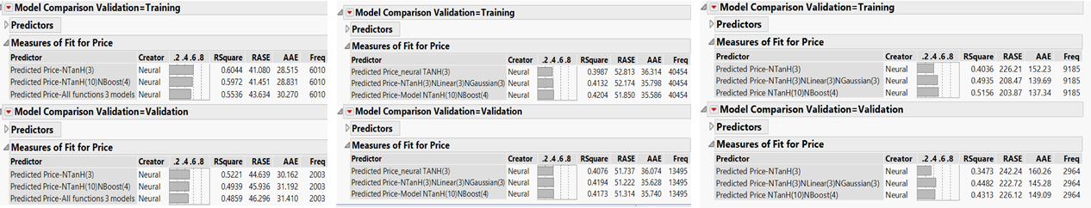
Best Neural Network Model
Cluster 1
Cluster 2
Cluster 3
 | NTanH(3) | NTanH(3)NLinear(3)NGaussian(3) | NTanH(3)NLinear(3)NGaussian(3)
R square (Highest) | 0.5221 | 0.4194 | 0.4482
RASE (Lowest) | 44.639 | 51.222 | 222.72
AAE (Lowest) | 44.639 | 35.628 | 145.28

Slide 23
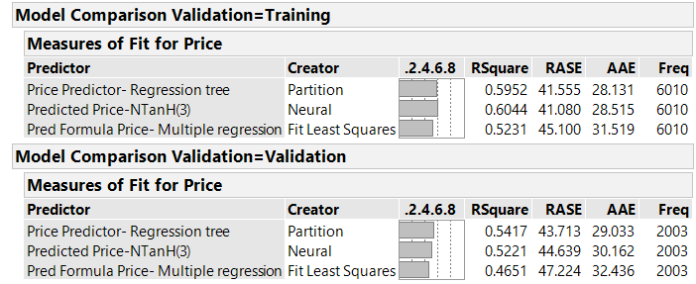
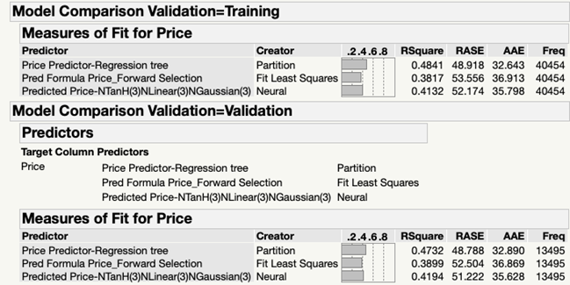
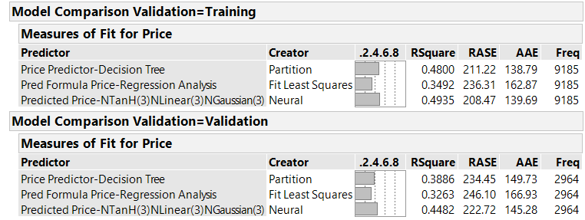
Model Comparison - All Clusters
Cluster 1 Cluster 2 Cluster 3
Regression tree
R square = 0.5417
RASE = 43.713
AAE = 29.033
Regression tree
R square = 0.4732
RASE = 48.788
AAE = 32.890
NTanH(3)NLinear(3)NGaussian(3)
R square = 0.4482
RASE = 222.72
AAE = 145.28

Slide 24
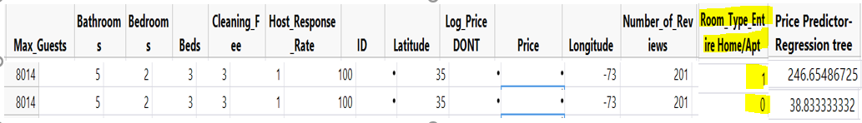
Conclusion
Cluster 1- Regression tree
8014 - new record added
Room type home/ Apt - maximum column contribution
Predicted variation when entire room type = 0 vs entire room type = 1
house location(longitude and latitude) and bedroom play a key role.
Potential host can determine price for their property.

Slide 25
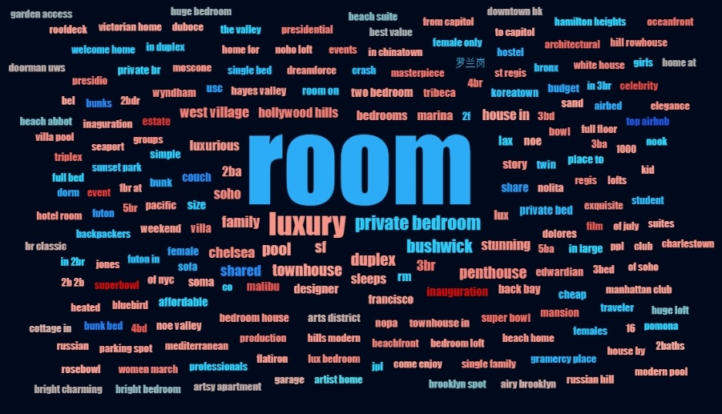
Recommendation
Customers pays a significantly lower price if they do not opt for the entire room/apartment, otherwise they pay a considerably higher price if they do opt for the entire room/apt.
Host makes a tidier profit by renting out the whole house vs just renting out a part of the house.

